Slide 1
Credit Report Education
TREC Course #35559
1 Hour CE Credit
Red Diamond Home Loans & WFG Title

Slide 3
Overview
Significance of credit
What does a mortgage credit report look like?
What do the scores need to be for a loan approval?
What are the implications and costs of a low score?
How can we improve a credit score?
What NOT to do in regards to credit
Unique scenarios
Common Misconceptions
Questions anytime!

Slide 4
Significance of Credit
Credit is one of the 3 most important factor in determining eligibility for a mortgage.
Credit
Debt-to-income ratio (credit report required to determine this accurately)
Down Payment funds
Credit will also control the program and interest rate a buyer can obtain.

Slide 5
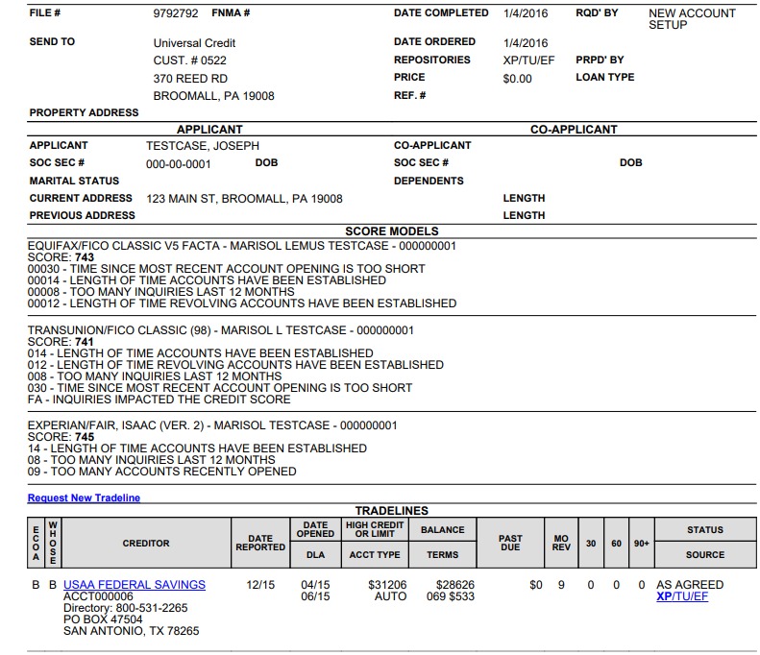
What does a mortgage credit report look like?

Slide 6
The content in a full report includes...
First few pages: Tradelines
Current Accounts, Derogatory Accounts, Collection/Charge Off
Following Tradelines:
Other Credit History, Public Records, Alert, Remarks, Trade Summary, Derogatory Summary, Source of Information, Inquiries, Creditors, and more disclosures.

Slide 7
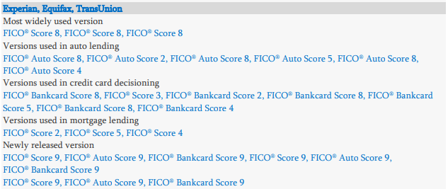
Why & How are mortgage credit scores different than consumer credit scores?
Not all scores are the same! ----------------->
There are Auto Scores, Bankcard Scores, and Base Scores.
Mortgage scores use an older Base scoring model - auto lenders and bankers often use more updated models, and a different calculating formula.

Slide 8
What are the differences?
NOTE: Mortgage lenders still using FICO model 2, 5, and 4.
Examples of updates in FICO Version 8:
Credit card usage (more penalty higher utilization/less for lower)
Isolated late payments (more forgiving for one/less forgiving for many)
Authorized user of credit cards (reduces the benefit of co-signing to prevent misrepresenting the individuals credit)
Small balance collection accounts (under $100 ignored)
Examples of updated in FICO version 9:
Third party collections that have been paid off no longer have a negative impact
Unpaid medical collections have less impact
Rental history may be reported and taken into account

Slide 9
Where can I check my scores?
Credit Karma: uses Vantage scores, but will reflect relatively closely to FICO scores (generally Credit Karma scores are higher than mortgage scores)
Discover Credit Scorecard: Reports your TransUnion credit score and report (1 of the 3 we consider). They use FICO Score 8 - so a more updated version than what a mortgage report will reflect.
AnnualCreditReport.com: Free annual credit report. Does not include credit scores, just tradelines.
MyFICO: more accurate, reports all 3 bureaus, costs money for the service.
I would always recommend having your buyers understand their scores as a first step in looking for a home. When we pull the mortgage report, it will be a hard inquiry whereas credit karma for example will not show as an inquiry at all.

Slide 10
What is the minimum score for a loan approval?
An FHA loan approval generally requires a minimum score of 580,
It could be possible to find a lender that will go below 580, but this will require a higher down payment (10% or more), low debt-to-income ratio, and will have a high interest rate.
Conventional loans and more conservative lenders have a minimum score of 620.

Slide 11
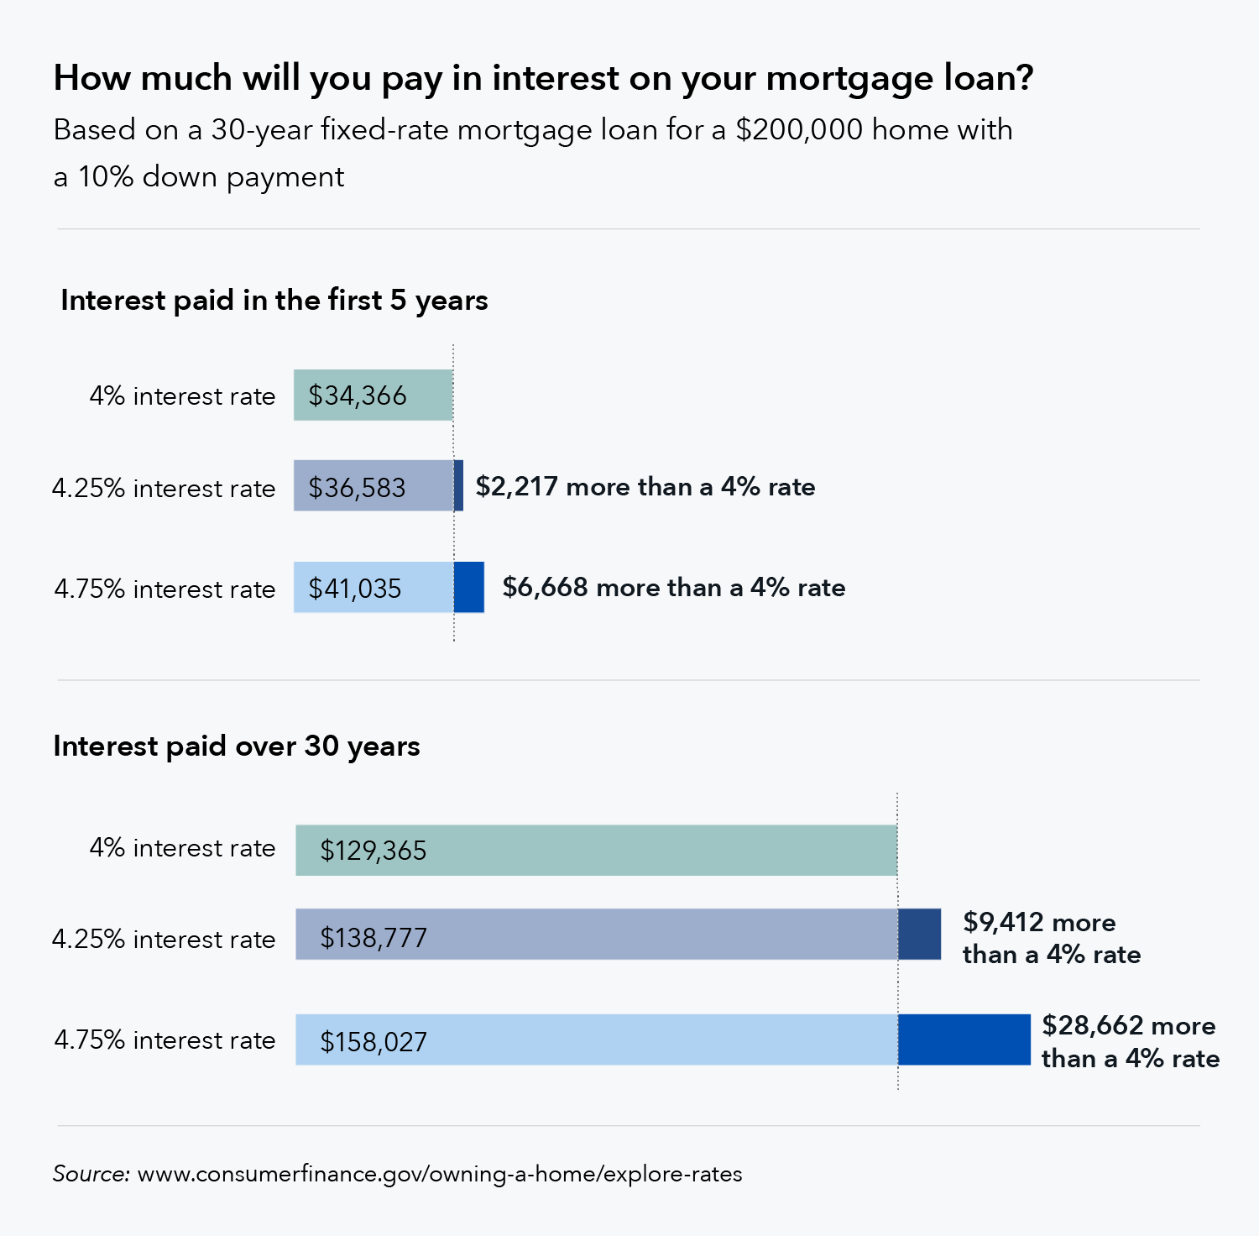
What does a low credit score cost in a mortgage?
Low credit scores can cost a significant amount of money over the life of the loan solely based on LLPAs and investor adjustments to the price.
This margin goes directly to Fannie Mae and/or FHA due to the long-term risk of the lower score.
These implications are important to consider when obtaining any type of loan - not just mortgages.

Slide 12
How can we improve a credit score?
What-if tool to run scenarios on paying down balances or removing accounts
Pay for Delete Letter
Goodwill Letter
Disputes ***** (more on this later)
Credit Repair professionals
Note: It is now free to FREEZE your credit scores - this could be a great option if you are not looking to take out credit in the near future.

Slide 13
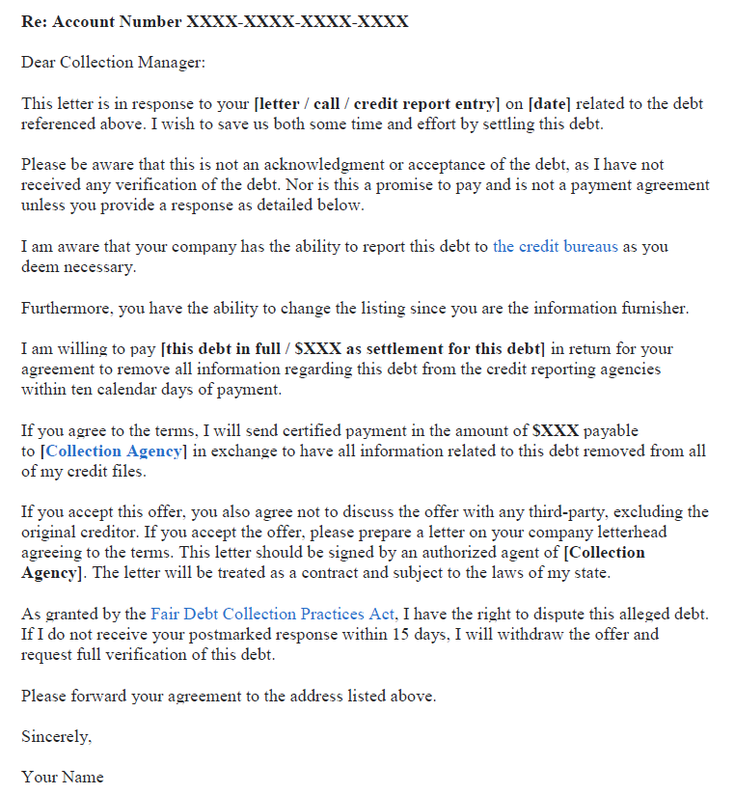
Pay for Delete Letter Example:
This is a great option for any collection accounts that still have a balance on the report.
Has the potential to significantly help the score.

Slide 14
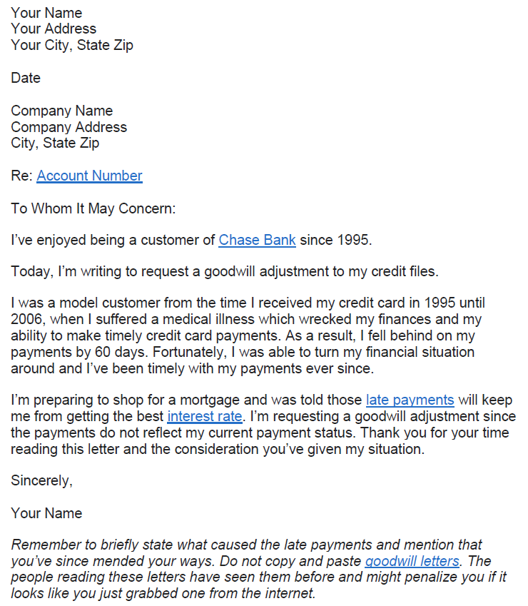
Goodwill Letter example:
Could potentially get late payments removed, must have extenuating circumstances.

Slide 15
What NOT to do...
Pay off collection accounts to a zero balance - often this will not improve the score, it will simply update the balance of the account to zero. If you have an outstanding balance, you should try to pay for the removal of the account
Try to avoid any credit inquiries until you know your score is in range for an approval. Inquiries last 90 days can add up, bringing your score down.
Don’t get behind on payments if possible
Refrain from co-signing on anything you are not 100% confident about being paid on time and willing to add into your debt-to-income ratio
Try not to let credit card balances reach their limit (try to keep 30% or below)
Don’t close an old account - better to leave it open with a zero balance

Slide 16
Unique Scenarios: Investment Properties
Fannie Mae Guidelines:
Individual collection and non-mortgage charge-off accounts equal to or greater than $250 and accounts that total more than $1,000 must be paid in full prior to or at closing.
In a recent scenario this applied to medical as well.

Slide 17
Unique Scenarios: Disputed Accounts
Disputed accounts need to be removed from their disputed status before being able to obtain a mortgage.
(Disputed medical tradelines are an exception)

Slide 18
Unique Scenarios: Inaccuracies
If we can document and prove that an account is inaccurate, it is very likely we can get it removed.
If a credit score does not come in around what the borrower estimates, I will always send them a copy of their credit report for them to review and confirm everything is accurate.
Example: One client was ineligible for a loan due to inaccurate information, we then got it removed and he purchased a home with a VA loan.

Slide 19
Common Misconceptions
Are you out of luck if your spouse has a bad credit score?
Not necessarily!
Checking and knowing your score hurts it.
Definitely not! Credit karma as an example is free and non-impactful.
Closing accounts will help your score.
False. A variety of different types of open accounts, paid on time, helps your score!

Slide 20
Any Questions?
Thank you for coming!
We hope you learned a lot. Please never hesitate to contact Rachel or Mike with any credit or mortgage related questions.
Rachel: 817-733-5495
rachel@rdhloans.com
Mike: 817-832-8452
mporter@rdhloans.com

