Slide 1
Access Manager
Delegated Administration Briefing
2021

Slide 2
Freddie Mac Access Manager
Freddie Mac Access Manager is a self-service system that lets you create, manage, and provision your users' access to certain Freddie Mac Single-Family sourcing and servicing tools and applications.
Features:
  Allow customers to create and manage users and effectively control their access to Freddie Mac’s Single Family applications
  Enable customers to review access privileges on a periodic basis (recertification campaign)
  Provide self-service password management features
  Provide a collection of user provisioning and recertification management reports

Slide 3
Freddie Mac’s Access Manager
Delegated Administration Application
  Access Manager simplifies user provisioning, saving clients time and effort. With Access Manager, you can:
  Create and self-manage users and effectively control their access to our applications.
  Set users' application access at any time – you used to have to submit an online form that took several days to process. Now, you get your users' ID and password in minutes – saving valuable time.
  Experience faster turnaround on access requests – from days to minutes.
  Eliminate paper request forms and receive access in real time − automating the provisioning process also means no more paper forms, helping you make the move to a paperless environment.
  Improve transparency with on-demand reporting and periodic recertification of users.
  Lower your risk by occasionally recertifying your user base to facilitate accurate access to all tools.

Slide 4
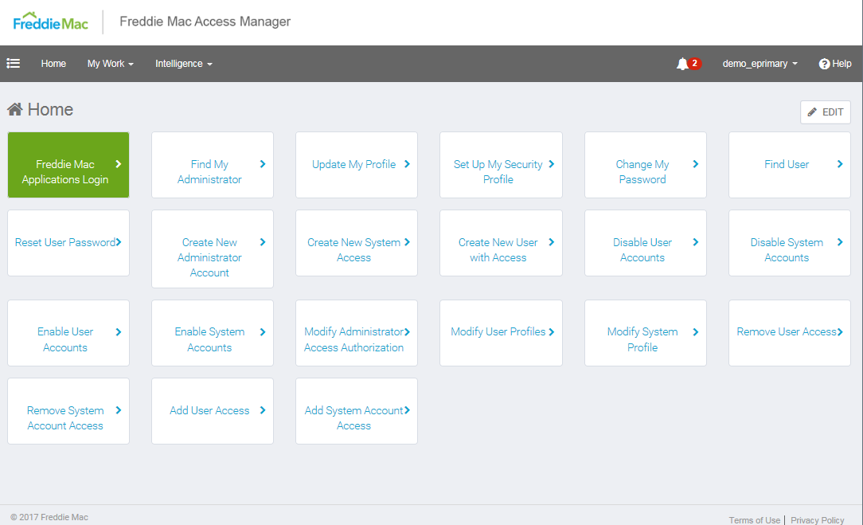
Freddie Mac Access Manager

Slide 5
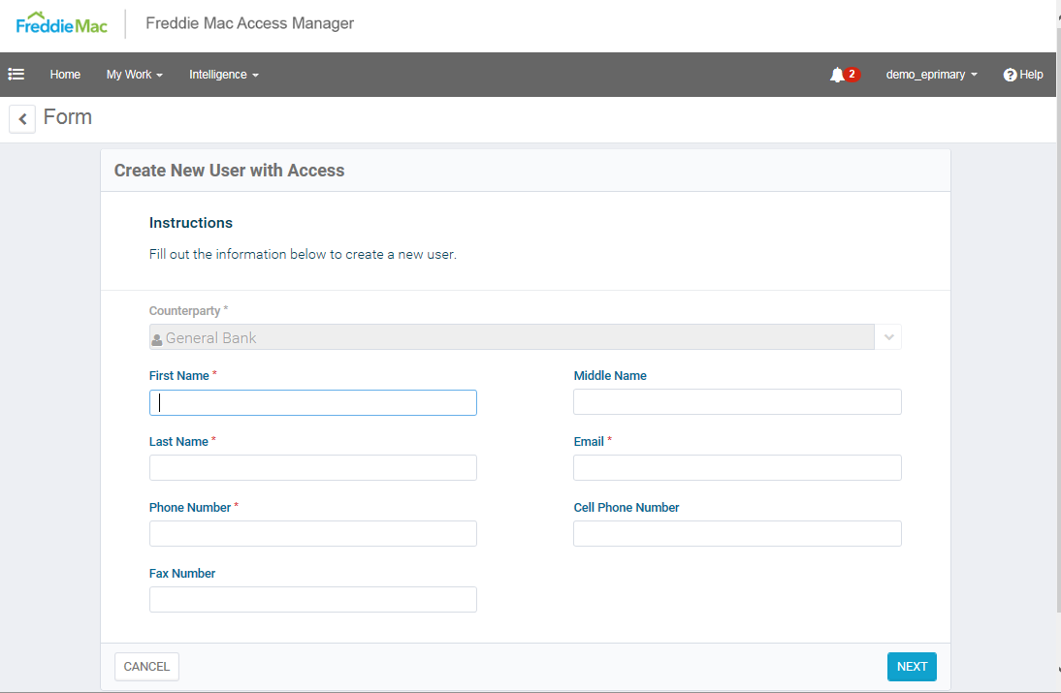
Create New User – Demographic Info

Slide 6
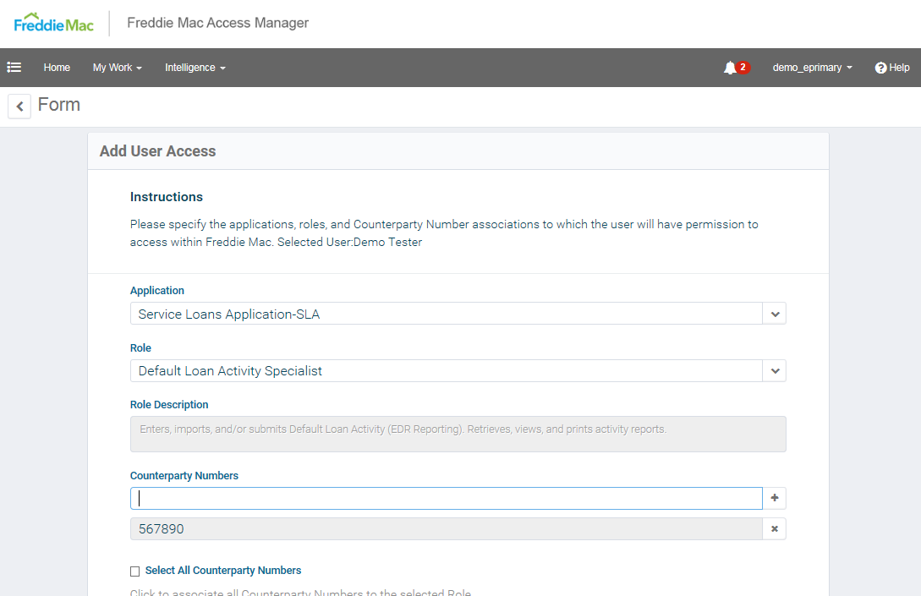
Create New User – Role Selection

Slide 7
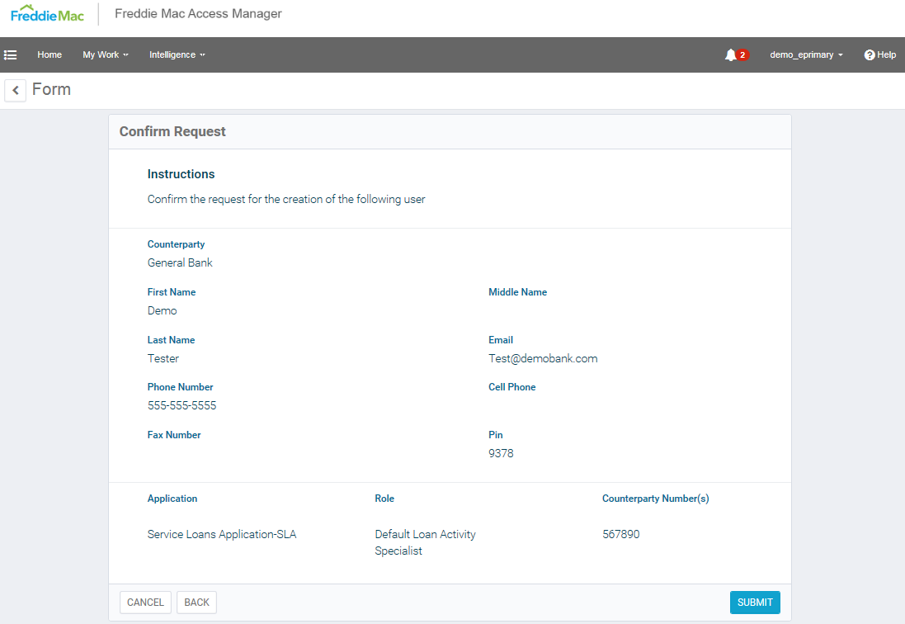
Create New User – Confirmation Page

Slide 8
What is the Onboarding Process?
Freddie Mac conducts a product briefing
Administrative structure is defined and administrators are identified
Company registers administrators to use the application
Administrators are provided applications credentials
Administrators register for and attend training
Administrators begin using Access Manager
Administrators conduct recertification of user population

Slide 9
Access Manager
Delegated Administrator Structure
Using Access Manager, an organization will be able to create and manage their own users and provision those users’ access to certain Origination and Servicing Tools.
Admin Type | Description
Executive Administrator | Manages all administrators within the organization (Must be VP or higher)
Primary Elevated | Allows administrators to provision user access to all current and future managed applications, Seller/Servicer or Related Third Party (RTP) Agreement numbers.
Primary Administrator | Manages application users within the organization and secondary administrators
Secondary Administrator | Manages application users within the organization
Freddie Mac customers will be required to delegate at a minimum:
  One Executive with Primary Administrator
  One additional Primary Elevated or Primary Administrator
  Secondary administrators are optional based on the organizational structure.

Slide 10
Access Manager Administrator Training
Training sessions will be conducted via interactive webinars on Tuesdays.
Administrators must register for training sessions on Freddie Mac website
Additional training materials are available online for post-training reference

Slide 11
Conducting User Certification Campaigns
Each customer must certify that employees with access to Freddie Mac systems have the correct user access:
  User Access = Application and Role
Certification campaigns are initiated by Freddie Mac on agreed upon frequency (default: every 12 months)
Administrators or designated certification users can now review and update user access. These individuals will quickly recertify their users’ application access and roles within their organization on a periodic basis.
The main type of certification campaign is listed below:
For example: Should John Smith have access to the Service Loans Application with the “
Certification Type | Description
Entitlement Access | Should the user have this specific user role within this application? Example: Should John Smith have access to the Service Loans Application with the “Loan Activity Analyst” Role associated to account # 123456?
Notes:
Add screenshot from UI

Slide 12
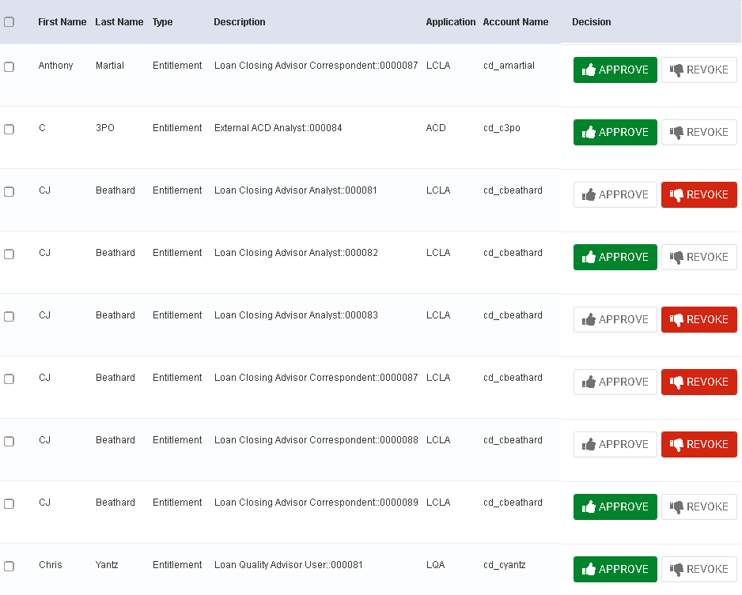
Certification Example

Slide 13
Delegated Administration Day to Day Activities
Administrators can start managing user access with the following features:
  Create New Users
  Add / Remove User Access
  Enable / Disable Users
  Reset User Password
  Manage Administrators

Slide 14
Appendix –Applications
Application Acronym | Application Name | System Purpose
LPA | Loan Product Advisor | Loan Product Advisor – the cornerstone of Freddie Mac Loan Advisor Suite – gives you access to Freddie Mac credit requirements and view of credit risk so you can easily assess your loan’s overall underwriting risk. It's our next generation in automated underwriting.
LQA | Loan Quality Advisor | Loan Quality Advisor provides you with information about Freddie Mac’s risk assessment and eligibility requirements at the point in the process when it is most useful to you.
LCLA | Loan Closing Advisor | Loan Closing Advisor, Freddie Mac's UCD collection solution UCD, helps you validate that your closing data align with the UCD. Loan Closing Advisor helps drive efficiency by providing actionable feedback on the accuracy of your UCD XML file to assist you in identifying and correcting errors before you close a loan.
LCVA | Loan Coverage Advisor | Loan Coverage Advisor calculates and tracks the selling rep and warranty relief date for every loan sold to Freddie Mac, based on the requirements under the rep and warranty framework. You can also use the tool to search for other critical loan-level information.
CAC | Correspondent Assignment Center | Correspondent Assignment Center simplifies data sharing between correspondent lenders and their aggregators.
LSA | Loan Selling Advisor | Loan Selling Advisor integrates all secondary marketing functions, from pricing to contracting to funding to loan delivery, making it easier for sellers to deliver loans to Freddie Mac – and deliver results for their business.

Slide 15
Appendix – Applications
Application Acronym | Application Name | System Purpose
STM | Servicing Transfer Manager | Transfer of servicing submission requests, simplified. Identify and submit subsequent transfer of servicing requests to Freddie Mac. You can also enter into electronic agreements with your transferee Servicer.
SPP | Servicer Performance Profile | Servicer Performance Profile is your key source to track and improve your servicing performance. It provides comprehensive monthly measurements to assess your results in the following categories: Default Management Metrics (core and supplemental), File Review Metrics, and Investor Reporting Metrics.
DFAS | Default Fee Appeal System | Default Fee Appeal System is a Web-based system that allows Servicers to submit appeals for State foreclosure timeline compensatory fees and late foreclosure sale reporting compensatory fees. The Default Fee Appeal System automates the appeals process and provides greater clarity, transparency and communication between Servicers and Freddie Mac for appeals.
WP | Workout Prospector | Workout Prospector is a web-based application that gives you the ability to analyze, structure, and send alternative to foreclosure recommendations to Freddie Mac electronically, or aid you in exercising your delegated authority to enter into alternative to foreclosure on behalf of Freddie Mac.

Slide 16
Appendix –Applications
Application Acronym | Application Name | System Purpose
BI | Business Intelligence | Our business intelligence solution is like having a digital finger on the pulse of your operations. Easily monitor your loan data, quickly identify trends or anomalies – and make decisions based on data and analysis.
BPO Direct | BPO Direct | Order a property value in seconds. BPODirect is an avenue to order broker price opinions (BPOs) and automated valuation models (AVMs). It includes robust details needed for your assessment such as, comps, recent sales, as-is pricing and estimated pricing of the property with repairs.
Cash Manager | Cash Manager | Manage cash payment activity (i.e., amounts due and drafting) while you reconcile investor reporting and accounting.
CoPA | Condo Project Advisor | Fast, simple condo waivers for greater purchase certainty. Condo Project Advisor lets you request unit-level exceptions for existing condominium projects early in the loan origination process, so you can close more condominium loans.
SDC | Servicing Data Corrections | The tool offers an automated and quick way to: Submit/track post-settlement data corrections requests Submit/track REO data correction requests Submit/track HAMP recast data correction requests View/track loan-level data correction requests*

Slide 17
Appendix – Applications
Application Acronym | Application Name | System Purpose
EDR | Electronic Default Reporting | Report prior month’s default and bankruptcy loan activity (status and events) in our electronic default reporting (EDR) tool within the first three business days of the current month.
eBill | eBill | eBill is an electronic portal that enables you to view your monthly invoices online. Through eBill, you’ll be notified when an invoice is available for selling and servicing of performing and non-performing loans. You can retrieve invoices as soon as they are available, view loan-level information and review draft account information.
eList | Exclusionary List | The Exclusionary List (eList) excludes individuals from participating in transactions or doing business, directly or indirectly, with Freddie Mac. Seller/Servicers are required to use eLIst in accordance with the Freddie Mac Single-Family Seller/Servicer Guide (“Guide”) and must not use eList for any other purpose without Freddie Mac’s written permission.
FSR | Foreclosure Sale Reporting | Report foreclosure sales (REO, third-party sales, FHA/HUD VA conveyances and deeds-in-lieu) within 24 hours from the date of sale or other action to begin REO processes, settlement.
ECO | Evaluate | Compare | Optimize℠ | Data is useful only if we can see what it means. Freddie Mac created ECO so mortgage professionals can evaluate performance, compare their performance to competitors’ and optimize lending strategies. ECO turns valuable mortgage market data into something even more precious: Insights.

Slide 18
Appendix – Applications
Application Acronym | Application Name | System Purpose
LCA | Loan Collateral Advisor | Appraisals submitted to Freddie Mac through the UCDP® are seamlessly integrated and automatically flow to Loan Collateral Advisor – to help you more easily analyze appraisal reports and get a view of their valuation risk.
LLR | Loan Level Reporting | Report borrower payment activity each month for the current accounting cycle. Your timely and accurate reporting gives Freddie Mac a better understanding of your portfolio while improving data integrity.
PFDC | Post Fund Data Correction Tool | Your post-fund data correction requests for origination and delivery data delivered through Loan Selling Advisor® can be submitted through our automated Post-Fund Data Correction tool.
QCA | Quality Control Advisor | Quality Control Advisor allows you to view samples, upload loan files, view loan review status, upload missing documents, manage remedies and view multiple reports.
PAID | Payments Automated Intelligent and Dynamic | As part of our Reimagine Servicing® initiative, we’re launching PAID - a new tool that will replace the Reimbursement System. It's a reengineered experience that will allow you to submit and view expense statuses clearly.

Slide 19
Appendix – Applications
Application Acronym | Application Name | System Purpose
REVP | Real Estate Valuation and Pricing | Receive information to help you ensure acceptable pricing on short sales and foreclosure sales based on real estate assessed values.
Resolve | Resolve | As part of Reimagine Servicing®, we’re introducing Resolve - an innovative loss mitigation and end-to-end default management solution, developed from client insights and industry partner collaboration. Resolve uses automation and seamless integration to deliver rapid, rules-based workout decisions to Servicers. It's a new technology experience and a new way of reaching resolution for mortgage relief.
UcountP | Unified Counterparty Experience System | The Unified Counterparty Experience System® (UCountSM ) is a user-friendly system that has replaced Guide Forms 16SF Annual Eligibility Certification Report, and 1107SF, Seller/Servicer Change Notification Form, and the Annual Eligibility Website, which is what you previously used to file annual eligibility and change reporting

Slide 20
References
Administrator Registration Form
  https://sf.freddiemac.com/general/freddie-mac-access-manager-administrator-registration-form
Getting Started with Freddie Mac Access Manager Video Overview
  https://sf.freddiemac.com/training-tutorials/get-started-freddiemac-access-manager.aspx
Training Link
  Self-guided Training Link (need to register to Freddie Mac Learning Center) https://learn.freddiemaclearning.com/Saba/Web_spf/NA3P1PRD0123/guest/ledetail/cours000000000005260
Freddie Mac Access Manager
  https://www4.freddiemac.com/identityiq
Delegated Administration Support Mailbox
  CSA_Operations@freddiemac.com

Slide 21


