Slide 1
Jumbo Non-Delegated
Key Jumbo Overview and Program Parameters
Last updated: February 8, 2022
Truist Bank is an Equal Housing Lender. ©2022 Truist Financial Corporation. Truist, Truist Purple, and the Truist logo are service marks of Truist Financial Corporation.

Slide 2
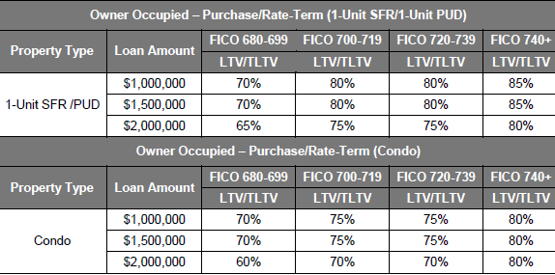
Owner Occupied Maximum Loan-to-Value (LTV)
The chart below outlines the temporary product restrictions for Key Loan Program.
Note: Second Home cash-out refinance and investment property transactions are ineligible.

Slide 3
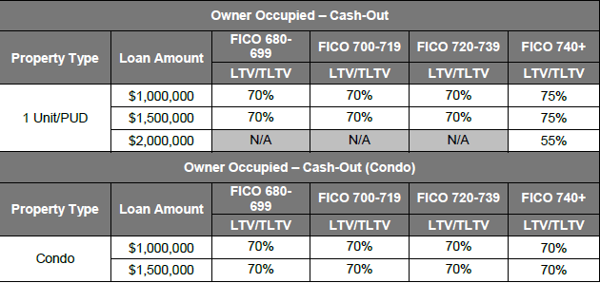
Owner Occupied Maximum Loan-to-Value (LTV)

Slide 4
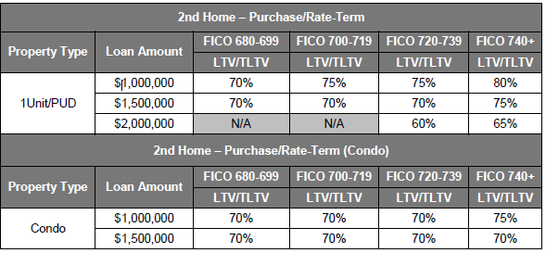
Second Home Maximum Loan-to-Value (LTV)

Slide 5
Key Loan Program Temporary COVID-19 Related Guidance
The following temporary COVID-19 related guidance applies to non-delegated Key Loan Program transactions until further notice:
Income Trends and Stability for Non-Fluctuating Employment (i.e. salaried and non-fluctuating/non-variable hourly)
If the Underwriter determines that the income interruption/furlough (e.g. reduced, discontinued) occurred solely due to the economic conditions created by the pandemic, and it is documented that the borrower is back at work full-time, the base earnings (i.e. salaried income or non-fluctuating hourly) can be used for qualifying no matter if the year-to-date figures are stable or decreasing as a result of COVID-19. The Underwriter’s written analysis of the income should include this determination.
Declining Income Trends and Stability for Variable/Fluctuating Employment (i.e. fluctuating/variable hourly, overtime, bonus, and commission)
Due to the recognition of the COVID-19 pandemic as an on-going event, breaks in employment impacting year-to-date income cannot be ignored in the income calculation. Because of the on-going nature of the pandemic, it must be treated as a current factor in employment and not a singular event, such an isolated injury, causing a break in employment.

Slide 6
Key Loan Program Temporary COVID-19 Related Guidance
The following temporary COVID-19 related guidance applies to non-delegated Key Loan Program transactions until further notice:
Forbearance Eligibility Requirements
Status of all mortgage loans on which the borrower is obligated must be determined.
Examples of acceptable document include: loan payment history, mortgage payoff statement, mortgage account statement, and verification of mortgage.
A borrower who is not current and has missed payments on any mortgage loan is eligible for a new mortgage loan if those missed payments were resolved in accordance with the requirements (review the table on the next slide).

Slide 7
Key Loan Program Temporary COVID-19 Related Guidance
Forbearance Eligibility Requirements Table
Resolution Method | Eligibility
Reinstatement | If the borrower resolved missed payments through a reinstatement, they are eligible for a new mortgage loan. Document the source of funds if the reinstatement was completed after the application date of the new transaction. Proceeds from a refinance may not be used to reinstate any mortgage loan.
Loss Mitigation Solution | If outstanding payments will be or have been resolved through a loss mitigation solution, the borrower is eligible for a new mortgage loan if they have made at least three timely payments as of the note date of the new transaction as follows: For a repayment plan, the borrower must have made either three payments under the repayment plan or completed the repayment plan, whichever occurs first. Note that there is no requirement that the repayment plan be completed. For a payment deferral, the borrower must have made three consecutive payments following the effective date of the payment deferral agreement. For a modification, the borrower must have completed the three-month trial payment period. For any other loss mitigation solution not listed above, the borrower must have successfully completed the program, or made three consecutive full payments in accordance with the program. Verification that the borrower has made the required three timely payments may include: A loan payment history from the servicer or third party verification service, The latest mortgage account statement from the borrower, and; A verification of mortgage. If the requirements above are met on existing mortgage loan being refinanced, the new loan amount can include the full amount required to satisfy the existing mortgage.

Slide 8
Key Loan Program Temporary COVID-19 Related Guidance
The following temporary COVID-19 related guidance applies to non-delegated Key Loan Program transactions until further notice:
Rental Income
Documentation evidencing current receipt of monthly rental income for each rental unit and/or rental property for the most recent two (2) months prior to closing is required. Loans closing after the 15th of the month require verification of rental income for the current month.
Documentation may include:
- Bank statement showing deposit of rental income amount as stated in rental agreement,
- Copies of cancelled checks (front and back) for rental amount as stated in rental agreement, or
- Other documentation that can establish borrower’s receipt of rental income amount as stated in rental
agreement (e.g. Venmo, PayPal).

Slide 9
Key Loan Program Temporary COVID-19 Related Guidance
The following temporary COVID-19 related guidance applies to delegated Key Loan Program transactions until further notice:
Self-Employed Borrowers
- The self-employed borrower VOE (Evidence of existing business) is required 20 days prior to the note date.

Slide 10
Key Program Highlights
Loans up to $2 million
Owner occupied primary residence and second homes – see COVID Overlays
One unit only
Salable product
Rate and term can include non-purchase money seconds seasoned 12 months
Maximum number of financed properties – 4
2X Close Construction to Perm (1X close is not allowed for non-delegated)

Slide 11
Underwriting
Clean Submissions
Submission Checklist – upload the file in checklist order
Upload credit documents in one upload when possible
Separate upload for disclosures
Update submission 1003 with verified information
Provide details on income calculations
Address large deposits
Address additional debt if noted on asset statements
Cover memo when additional details are needed
AUS is ineligible

Slide 12
Underwriting
Income
• Rental Income – must have 2 year landlord history - see COVID Overlays.
• Borrower must start employment before loan closing.
• For Salary employees we require 2 years tax returns:
- You can submit W2 transcripts with the actual W2s and returns will not be required.
- Written VOE cannot be substituted for W2s and/or Paystubs.
• Verbal VOEs – see COVID Overlays for Self-Employed Borrowers.
- Must be complete and within allowable timeframe – see specific details on pages 45-48
in the guidelines.
- The timeframe on electronic VVOEs is tied to the “information current as of” date, not the date
the document was pulled.
• Capital Gains is not an allowable source of income.
• Continuance of income:
- Retirement – 10 years.
- Trust Income – 7 years.

Slide 13
Underwriting
Self-employed Borrower documentation – see Key guidelines under “Income”
• Most recent two (2) years of individual, signed Federal tax returns with all schedules to include W2s, 1099, and K1s if applicable.
• Most recent two (2) years of corporate, S-Corp, LLC, and/or partnership (if applicable), signed federal tax returns with all schedules.
• A signed copy of the YTD balance sheet, regardless of corporate structure, and YTD profit and loss statement for the business (may not be more than 120 days old as of the note date).
• Business assets can be used for down payment, closing costs, and/or Reserves.
- Borrower must be 100% owner of the company.
NOTE: P&L statements must be audited when income reported on the P&L increases / decreases and the P&L income is used to qualify the self-employed borrower

Slide 14
Underwriting
Assets
• Large deposits
- Must be explained and sourced for both single and multiple deposits over a one month period exceed
50% of the total monthly income. If you are backing out the deposit form the verified funds an explanation
letter from the borrower is still required.
• When stocks, stock options, or mutual funds are the source of funds used for down payment or closing
costs, documentation evidencing the borrower’s receipt of liquidated funds is required, prior to closing.
• When stocks, stock options, or mutual funds are used for reserves, 70% of the value of the asset must be
considered; liquidation is not required.
• Retirement accounts
- Using the correct calculation on accounts on which the borrower has a loan.
Calculation: Vested Amount * 60% ‒ Outstanding Loan
Calculated Correctly
Vested $110,004.83 * 60% - $50,000 loan = $16,002.89
Calculated Incorrectly
Vested $110,004.83 - $50,000 loan * 60% = $36,002.89

Slide 15
Underwriting
Assets (continued)
Terms of Withdrawal for Retirement Accounts
- Is required when using the account for reserves
Reserves
- All loans require six months reserves up to $1 million (12 months for > $1M)
- Additional six months if retaining their current primary
- If you are excluding a debt with 10 or less payments, you need to include reserves to cover the balance
- 30-day accounts – include reserves to cover the balance

Slide 16
Underwriting
Credit – see COVID Overlays
Must meet minimum trade line requirements.
Identify possible undisclosed debt – bank statements, paystubs, etc.
Open revolving accounts with zero balance you must use min $10 payment in debt ratio.
HELOCs – must use the greater of 1% of the full line amount or the payment as noted on the credit report
or monthly statement.
Max DTI 43% (Self-Employed Borrowers doing a Construction to Perm Max is 38%).
REO properties
- Missing documentation for taxes and insurance.
- Missing documentation for sale & settlement (could also affect DTI and funds to close).

Slide 17
Underwriting
Property/Contract
Identify correct property type
- PUD or Condo name must match on the Appraisal, Title and Rider.
Personal property on the contract
- Cannot ignore if appraiser does not include it in appraisal value.
- Personal property may be considered a seller concession/seller contribution:
- Some items can be left for convenience (i.e. pool cleaning equipment or covers, lawn mowers, picnic tables, patio tables or sets).
- All others that are not considered customary – a value must be determined, if not by the
appraiser, then the underwriter. This value must be used to determine max LTV.
- You do not have to consider if the value is determined to be less than 2% of the property value or is less than $500.
Confirm owner of record matches Contract, Title and Appraisal
- If seller is an entity, you must verify the individual signing for the seller has the authority to do so.
Confirm address and county – must match appraisal, title, Flood cert., and closing documents
15 acres Max

Slide 18
New Construction
Final Inspections
MUST contain photos of the completed items. If the photographs in the original appraisal report represent
the subject property accurately, meaning completed construction, new photographs of the subject property
are not required.
Landscaping
It is expected that landscaping is installed on new construction properties. Unless the landscaping was specifically omitted from the contract, the appraiser should complete the report “subject to”. If it is omitted from the contract, the appraiser needs to specifically address, note any impact to value/marketability, provide a comp that closed with no landscaping, and adjust the comparables that have landscaping, if deemed appropriate.

Slide 19
1004D – Update and Completion
1004D Completion
The 1004D Final Inspection or Completion applies to both new construction finals and repair finals. Final inspections or 1004Ds must have required photos of the completed home or the completed repair.
Required interior photos for ALL appraisals, not just new construction, are the kitchen, all bathrooms, and the main living area. If there is a repair item and the appraisal was made subject to, then a photo of the repaired item must be included in the final.
On New Construction, if the rooms were complete and photographs were provided in the initial appraisal, new photos are not required.
1004D Update
Used when the appraisal report will be more than four months old on the date of the note to determine if the market value has declined in value since the date of the original report. Only a front photo of the subject is required.

Slide 20
Contract Changes
What if the contract is amended after the appraisal is completed?
If the contract is amended after the appraisal is completed, the lender must provide an updated contract to the appraiser if it is amended in a way that affects the description of the real property used by the appraiser. However, minor updates to the contract, such as changes to seller-paid closing costs or changes to the contract price, do not require an updated appraisal. Contract amendments that could affect the description of the property include:
Amendments due to revised plans/specs for new construction or remodeling.
Changes in the legal description, acreage and/or number of parcels conveyed.
Renegotiated seller concessions or sale price as a result of a home inspection revealing property damage or deferred maintenance.

Slide 21
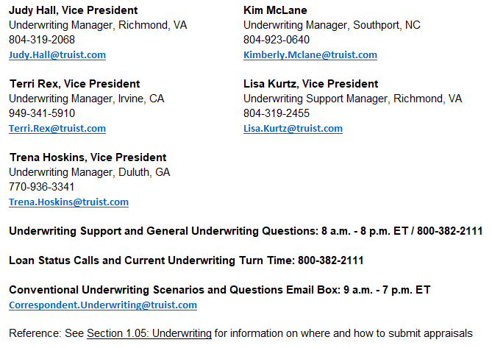
Underwriting
Section 1.01 The Correspondent Division Correspondent Seller Guide

Slide 22
Underwriting
KEY Loan Program Eligibility Checklist:
Is not mandatory, however highly recommended
Page 6 of the program – live link
This is your loan saver!

Slide 23
Questions & Answers

