Slide 1
Continuing Education
Presented by Mike & Rachel Porter
Sponsored by:

Slide 2
Technology & The Loan Process
How can we streamline the loan process via technology to benefit borrowers?
Search Engines & Social Media → Your Website
Ninety percent of consumers now start their real estate journeys on the Web, according to the National Association of Realtors, while 85% of buyers used a mobile device during the home buying process.

Slide 3
Your Online Presence
By utilizing search engine optimization (SEO) and relevant content, your website can be a major draw for clients and internet traffic.
Your website should be a professional reflection of your business with featuring listings, search options, and personalized content.
Important aspects of a modern real estate website design:
Mobile/smart phone friendly
Clean and modern design
Featured Listings
Effective Search functions
High quality images
Potential for lead generation

Slide 4
Home Page: Demo Website
Modern design, unique search capability, and fully customizable

Slide 5
Send clients from your website directly to the Mortgage Loan Application (Form 1003)
Our online platform, Maxwell, is a simple and secure interface for borrowers to utilize
from application to closing documents.
You (the Real Estate Agent) will be notified of important events throughout the process such as
appraisal ordered and received, clear to close approval, and when closing disclosures are sent.
We will regularly update the tasks with necessary documentation, guiding the borrower
with specific instructions every step of the way.
Both the Loan Estimate (LE) and Closing Disclosure (CD) can be sent and signed electronically for speed and efficiency at the beginning and end of the loan process.
Maxwell is available on mobile and sends regular email reminders to borrowers requesting necessary documentation. This will increase speed, efficiency, and save everyone time in the loan process.

Slide 6
Pre-Qualifications and Pre-Approvals
Credit is ordered online instantly via our vendor, Sarma. All we require is borrower’s authorization.
What-if Simulator:
Sarma’s What-if Simulator allows us to see what credit card payments or account issues will improve the borrower’s credit score.
This allows us to instantly provide borrowers specific credit advice on how to improve their score at the time of the loan application.

Slide 7
Electronic Signatures
Our online programs Ink-it and DocuSign allow our borrowers to sign the Initial Disclosures, Loan Estimate, and Closing Disclosures online via computer or even mobile phone. This improves the speed and convenience of transactions.

Slide 8
Desktop Originator: Fannie Mae’s Automated Underwriting System
Desktop Originator/Desktop Underwriter (DU) is the automated system we use to analyze the likelihood of the specific loan to be approved/eligible or ineligible under Fannie Mae Guidelines.
After the initial application and pulling credit, DU is a crucial step to Pre-Approving any borrower.
This program can also help us determine the purchase price a borrower may qualify for, and outlines specific findings such as risk, potential red flags, conditions, and observations.

Slide 9
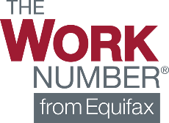

Slide 10
Loan application
Transmittal Summary
FHA/VA Addendums
Fees Worksheet
Loan Estimate
Service Providers List
Anti-Steering Disclosures
HOEPA Homeownership Counseling
4506-T
SSA-89
Closing Costs Worksheet
Closing Disclosure
VA Loan Analysis
VA Loan Summary
VOE

Slide 11
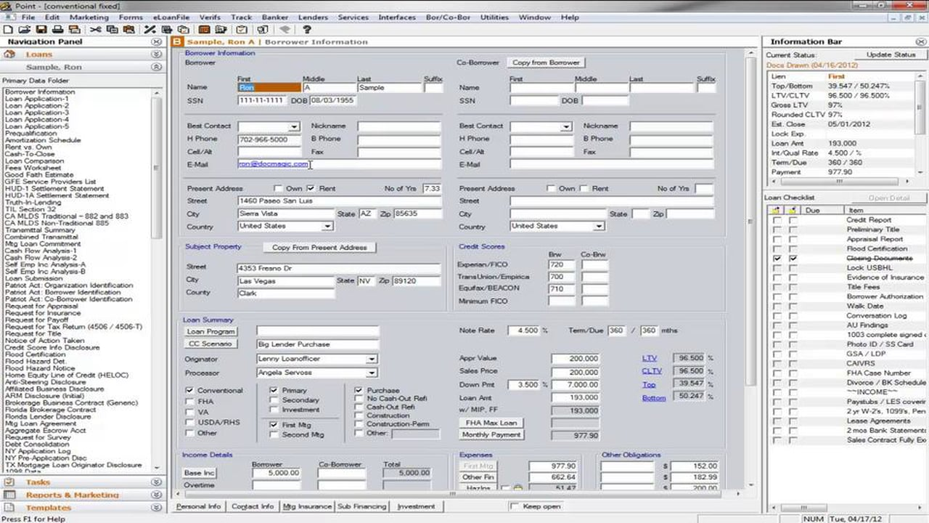

Slide 12
& finally, everyone’s favorite place:
The Closing Table

Slide 13
Thank you!

Slide 14
Interim Financing
What is the difference between a Pre-Qualification, Conditional Approval, Pre-Approval, Initial Underwriting Approval, Final Approval and Clear to Close?
Conditional approval/Pre-Qualification – Red Diamond can provide this in a few hours.
What can go wrong: Income turns out different than the borrower provided. The client does not have the cash to close. There was declining income.
Initial Underwriting approval: The clients initial documentation has been reviewed by the underwriter.
Final Approval & Clear to Close: All required docs are approved and signed off on!
Notes:
HAND OUT MY FORMS – CONDITIONAL APPROVAL FORM AND GO OVER THE YES NO QUESTIONS.
Is this confusing to anyone?
Income is different, there was declining income. There was a business loss.
Asset are not sufficient for down payment and closing costs.
Income may not be consistent enough – need a two year history to count it.
We will go over credit on a later slide: Credit score is pretty clear cut and good for 120 days. Past credit problems (charge offs, collections bk’s foreclosures all can impact approvals.)
Can’t take out new credit or it hits their debt to income
Other real estate owned counts against them. May not realize that up front.
based upon the initial information provided by the client, their credit score and credit profile the file meets the investor guidelines. Typically the file will be approved through an automated underwriting engine.

Slide 15
Who provides the underwriting guidelines for Mortgage loans:
Who are these entities and what do they do?
Fannie Mae & Freddie Mac
FHA
VA
Non QM – What are the options?
“The risk is transferred to these entities because the file was underwritten to their guidelines.”
Notes:
Fannie Mae and Freddie Mac are separate entities and have separate guidelines, however they are very similar.
Max Loan Amount in 2017 is $424,100.
FHA: Max Loan Amount in DFW in 2017 is $362,250.
VA: Max loan without a down payment is $424,100, with a loan amount is $1,million.
Non QM are loans that do not meet agency guidelines and may be more like stated income.
With different guidelines it gives us options if a client doesn’t meet one they may meet another.
Fha more typically is for lower fico and lower down payment because they don’t have as much risk based pricing.

Slide 16
Interim Financing
The 4 C’s – let’s discuss at a high level
Credit – Minimum credit score
Capacity – Debt to income ratio (the ability to repay the loan)
Capital – Down payment/cash to close
Collateral – Appraisal
“Only 4 critical issues to close a home loan. “
Notes:
FHA Minimum credit score is probably 580
Conventional minimum is 620
Max DTI is 43-55 depending upon the investor
Big issues are income and cash to close – credit can be figured out up front pretty easily.
Income: Need that two year history, need an income source that will meet the test. Capital gains needs to have a 3 year history for example.
Declining income can kill a deal.
Self Employed income is tough…we use the AGI figure on the tax return.
Appraisals have been very good this year.

Slide 17
Manufacturing a Mortgage:
Data and documents are transformed into a closed loan.
Documentation Validation – 4 C’s again:
Credit: Minimum credit score for program requirements (Mid Fico of both borrowers) LLPA’s?
Capacity: Income documentation for debt to income calculation (W-2’s, Tax Returns, K-1’s)
Capital: Asset documentation (Bank Statements) for down payment and reserve requirements
Collateral: The appraisal must meets underwriting requirements
Notes:
I like to say we CUSTOM MAKE MORTGAGES! You want to use a lender that will custom make the mortgage with the best terms and service!
Credit: We use the low middle score for both borrowers. The credit cost with Fannie can be high if the Fico score is low. 1 point off on a credit score can impact the pricing.
What are Loan Level Price Adjustments – Fannie Mae -
FHA and VA do not hit the borrower for a lower fico score.
Capacity – FHA has higher debt to income ratios, all DTI’s are really set by the Automated underwriting engines.

Slide 18
The 4-C’s by Loan Type
Breaking it down:
4 C’s and Conventional Loans:
Minimum credit score is 620 (no exceptions)
Max debt to income roughly 45
Down payment can be a minimum of 3% but most common minimum is 5%
Appraisal standards are set by Fannie Mae. They purchase owner occupied and non owner occupied properties.
4-C’s and FHA Loans:
Minimum score is 580
Maximum debt to income is 50%
Down payment is 3.5%
Appraisals are completed by FHA approved appraisers.
4 C’s and VA Loans:
Typical minimum of a 620 score.
Maximum debt to income can be as high as 55%.
There typically is not a down payment requirement except on higher balance VA loans over $453,100.
Appraisals are completed by VA approved appraisers.
Notes:
There are variations in the guidelines between investors.
Jumbo investors have even more stringent requirements than Fannie Mae and Freddie mac.
Jumbo investors set their own underwriting guidelines and typically don’t use agency guidelines.

Slide 19
Make sense out of Mortgage Insurance
PMI, MIP, VA Funding Fee?
What’s up with all of this?
Guarantee’s the investor on the loan against loss…does not repair the property.
Private Mortgage Insurance insures conventional loans and jumbo loans
Mortgage Insurance Premiums insure FHA loans
VA utilizes a VA Funding Fee to guaranty their loans
High credit scores have a low cost of PMI, The higher the LTV the higher the PMI cost.
MIP does not factor in the credit score.
VA does not factor in the credit score
Notes:
Who benefits from the insurance? The Investor, not the borrower.
Conventional PMI is lower with better credit scores
FHA & VA do not charge more for lower credit scores. (this is why they are a better fit for lower credit score borrowers)

Slide 20
Home Loan Manufacturing Steps:
Initial Documentation Required:
In 2014 the Loan Estimate and the Closing Disclosure replaced the GFE and the HUD1.
We are required to send a Loan Estimate within 3 days of the client’s application.
We are required to send a Locked Loan Estimate upon locking the clients loan.
We are required to send the appraisal to the client and receive their acknowledgement of receipt.
We are required to send the closing disclosure 3 days prior to closing to be signed by the client.
Notes:
Tell your clients a little about the new mortgage process.
3 sets of disclosures must be signed during the processing of their loan.

Slide 21
Manufacturing the loan means putting a complete file together:
Minimum credit score - Maximum Debt to Income
Maximum Loan to Value - Loan must by approved by the automated underwriting system
Two year history required for income -
60 days of bank statements required - Most recent 30 days of paystubs
Tax Returns for Self Employed borrowers
“All of these factors and more go into the loan approval. All situations are different and specific issues will raise other conditions”
Notes:
All loans we produce are paperless and all work with our clients and investors is via paperless transmission in secure environments.

Slide 22
Banker vs. Broker: What’s the difference?
The Banker prepares the loan estimate and closing disclosure, the broker does not.
The Banker orders the appraisal from their own system, the broker does not.
The Banker funds it’s own loans, the broker does not.
The Banker is responsible for preparing the closing documents, the broker is not.
The Banker closes the loan in it’s own name, the broker does not.
Summary: A banker controls the full transaction while a broker uses the services of a lender to underwrite, close and fund a transaction.
Notes:
Red Diamond Home Loans is in my estimation the only independent mortgage banking company that is based in Southlake Texas.
IT’S A TOUGH JOB SETTING UP THE COMPANY AND RUNNIGN IT AND REQUIRES CAPITAL TO GET IT DONE.
BECAUSE OUR FOCUS ON JUST THE MORTGAGE BUSINESS I THINK WE CAN DO A BETTER JOB WITH BETTER EXECUTION THAN THE BANKS.

Slide 23
Loan Pricing Variances
Loan Pricing:
How can there be differences?
Why are their differences?
What is a loan worth?
Different companies sell loans for different values.
Pricing has a company net worth component. A company with no net worth will realize a lower value for their loans…like a brokered loan.
Correspondent loans have higher values.
What is the companies cost to produce the loan?
Why are costs different between some companies?
Notes:
Red Diamond Home Loans is in my estimation the only independent mortgage banking company that is based in Southlake Texas.
IT’S A TOUGH JOB SETTING UP THE COMPANY AND RUNNIGN IT AND REQUIRES CAPITAL TO GET IT DONE.
BECAUSE OUR FOCUS ON JUST THE MORTGAGE BUSINESS I THINK WE CAN DO A BETTER JOB WITH BETTER EXECUTION THAN THE BANKS.

Slide 24
How fast can we close?
Expected Loan Timeline
How fast can we close?:
Day 1: Application & Conditional Approval & Receive the Receipted Contract to start the clock, We need to issue preliminary disclosures before we can order the appraisal.
Day 2: Order the appraisal and Open Title with Title Company
Day 3: Receive all borrower documents
Day 4: Submit to underwriting (two days in underwriting)
Day 6: Receive Approval from underwriting
Day 7: Ask for other conditions
Day 8: Appraisal Complete
Day 9: Submit the appraisal back to the underwriter.
Day 10: Clear to Close
Day 11: Prepare Closing Disclosure
Day 14: Loan Closing
Red Diamond final approved a VA loan in 9 business days!
“This timeline depends upon the client, and their ability to move quickly and provide the documents that we need”
Notes:
What’s the fastest we can close?
If the file is a conditional approval we can move very quickly.

Slide 25
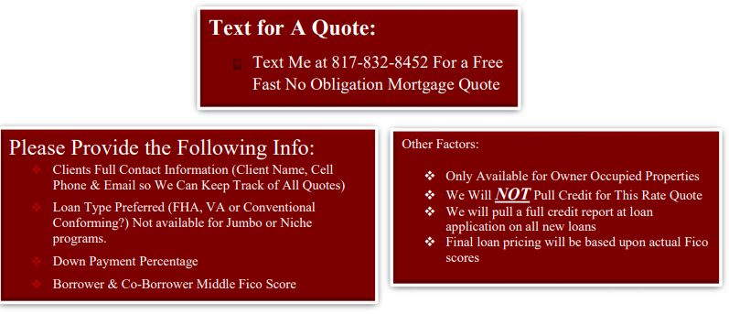
Notes:
Red Diamond Home Loans is in my estimation the only independent mortgage banking company that is based in Southlake Texas.
IT’S A TOUGH JOB SETTING UP THE COMPANY AND RUNNIGN IT AND REQUIRES CAPITAL TO GET IT DONE.
BECAUSE OUR FOCUS ON JUST THE MORTGAGE BUSINESS I THINK WE CAN DO A BETTER JOB WITH BETTER EXECUTION THAN THE BANKS.

Slide 26
VAHomeLoanCompany.com a Division of Red Diamond Home Loans, LLC
We are working to expand our VA business. VA Loans are great loans for the Veteran and a zero down payment option. We’re here to help with those deals. There are $1.7 million Veterans in Texas, second behind California.
Notes:
Red Diamond Home Loans is in my estimation the only independent mortgage banking company that is based in Southlake Texas.
IT’S A TOUGH JOB SETTING UP THE COMPANY AND RUNNIGN IT AND REQUIRES CAPITAL TO GET IT DONE.
BECAUSE OUR FOCUS ON JUST THE MORTGAGE BUSINESS I THINK WE CAN DO A BETTER JOB WITH BETTER EXECUTION THAN THE BANKS.

Slide 27
Hey, did you know…
Now for story time!!

Slide 28
Hey, did you know…
Great Stories…a good way to get to know the business!
LL: 6 different gift letters, some from Macau (The City of Dreams)
MB: Occupancy questions because of existing rental properties
NOO Purchase by 85 year old for his daughter (Why NOO?)
VA Loan: Borrower deployed to Kosovo, Need a POA., has to have original signatures, does mail service work from Kosovo? Also, a non-purchasing spouse, most won’t accept a POA.
Doctor relocation with employment agreement – New contract does not provide for guaranteed income (can’t be used for a Fannie Mae loan.)
Client with capital gains income – must have a 3 years history of capital gains…very unusual to have consistent capital gains.
Hurricane impacts: Need a POA because of the hurricane right before closing
Non-resident alien loans – need to have a current/updated visa even if they have resided in the US for many years.

Slide 29
Hey, did you know…
Great Stories…a good way to get to know the business!
Expat Lending: With no established US credit you can’t sell a loan to Fannie Mae or FHA. Must be a private investor.
Expat: All foreign documents must be translated into English by a US translating company.
Expat: Full qualifying with US income is required. No credit in the US is okay. Asset for closing must be transferred to a US financial institution.
Credit Counseling/clean up for Jumbo’s: Jumbo credit scores are much higher…typically a 700 minimum. Need to clear up any credit problems.
Client working overseas – can use electronic signatures for preliminary docs but must have a valid POA or live signatures at closing.
Multiple Investment Properties – no problem up to a certain # of units…typically a max of 4 NOO & 1 OO properties.
Divorce – Need the full divorce decree to include all debt obligations.
New Construction – building a new home larger/more expensive than the comparable properties will create appraisal problems.
Borrower with a low score – can be removed to avoid the hit on the low score but the income will be removed from the deal.

Slide 30
Hey, did you know…
Great Stories…a good way to get to know the business!
Marriage & Texas Law – Because of the community property laws in Texas the Co-Borrower will be on Title & Deed even if not on the note.
VA rules for co-borrower not on the note…still must include the co-borrowers debts but not the credit score or income.
FHA rules for co-borrower not on the note -
Conventional rules for co-borrower not on the note: Co-borrower credit, debts and income are not part of any calculations.
Gaps in Employment: Any gap in employment can create an approval problem so it might be better to leave that co-borrower off the note.
Retaining your existing residence and renting it: With a new lease we can use 75% of the rental income from the old house.
Bridge Loans: Because contingency’s are not available a bridge loan is an option…what are the pitfalls & benefits.
Construction/Permanent Loans: What are the issues? What does a two time close mean? What is the role of a bank vs. mtg bank in a const. loan? What are the costs and what type of cost savings can you get on a two time close…R18 rule in Texas.

Slide 31
Hey, did you know…
Great Stories…a good way to get to know the business!
Relocating to Texas – We closed a Charles Schwab employee on a bridge loan…what happens after that?
Land to Property Value: what if I want to buy a tear down and build my dream home? How does that work?
Cash Out Transactions: Why would I do a cash out? What are the rules in Texas? What are the costs?
Credit Problems: How can I get my credit cleaned up?
Mortgage Insurance: When does PMI drop off my loan?
VA Purchase for a non-married borrower – great story…what are the issues – “My fiancé wants to get married…???”
How fast can I close? We can get a clear to close in 8 days! With a client that has all his docs in order!
How can my client get a quick quote? We have a TEXTFORAQUOTE.COM Site. Text me and get a rate quote in return!
Why are rates different? I want to get the best deal for myself and my clients…how do I do that?

